Slide 1
The week 11 interim interview presentation on HECC-IT
Hypertext Editing and Creation Code Integrated Toolkit
A toolkit for making hypertext games
by Rachel Lowe

Slide 2
Why am I doing this project
It looked interesting
Making a thing that others can make things with
Might actually be of some use to someone!
Nice change of pace from everything else
Art reasons
You ever just make a game for the sole purpose of getting stuff off your chest
Logistics
Doesn’t require specialised hardware/software

Slide 3
The design goals
Make a tool for people who are indecisive.
Most existing tools are either 100% text-based (inform, squiffy, undum, etc) or 100% GUI-based (storyspace, twine, TADS, etc)
Some tools almost allow both, but awkwardly
Can convert twee code to twine, awkward to decompile (especially on Windows)
Inklewriter to/from .ink code: really longwinded
HECC-IT solves this problem
User can write .hecc code or use the OH-HECC GUI to help them write it
User can use HECC-UP to convert .hecc into a game
Make the games easy (technically) to play
Browser-based, 100% clientside, HTML/JavaScript
If people can’t use the outputs, what’s the point?
Follow the Treaty of Babel standard for Interactive Fiction Bibliography
So it’s more legit basically

Slide 4
The Objectives for the MVP
Create a system for playing hypertext games via a web browser
The HECCIN Game
Establish a language that can be used to define hypertext games
HECC
Create a utility that can parse that intermediate code into a playable hypertext game
HECC-UP
Create a GUI program that can be used to create that intermediate code
OH-HECC

Slide 5
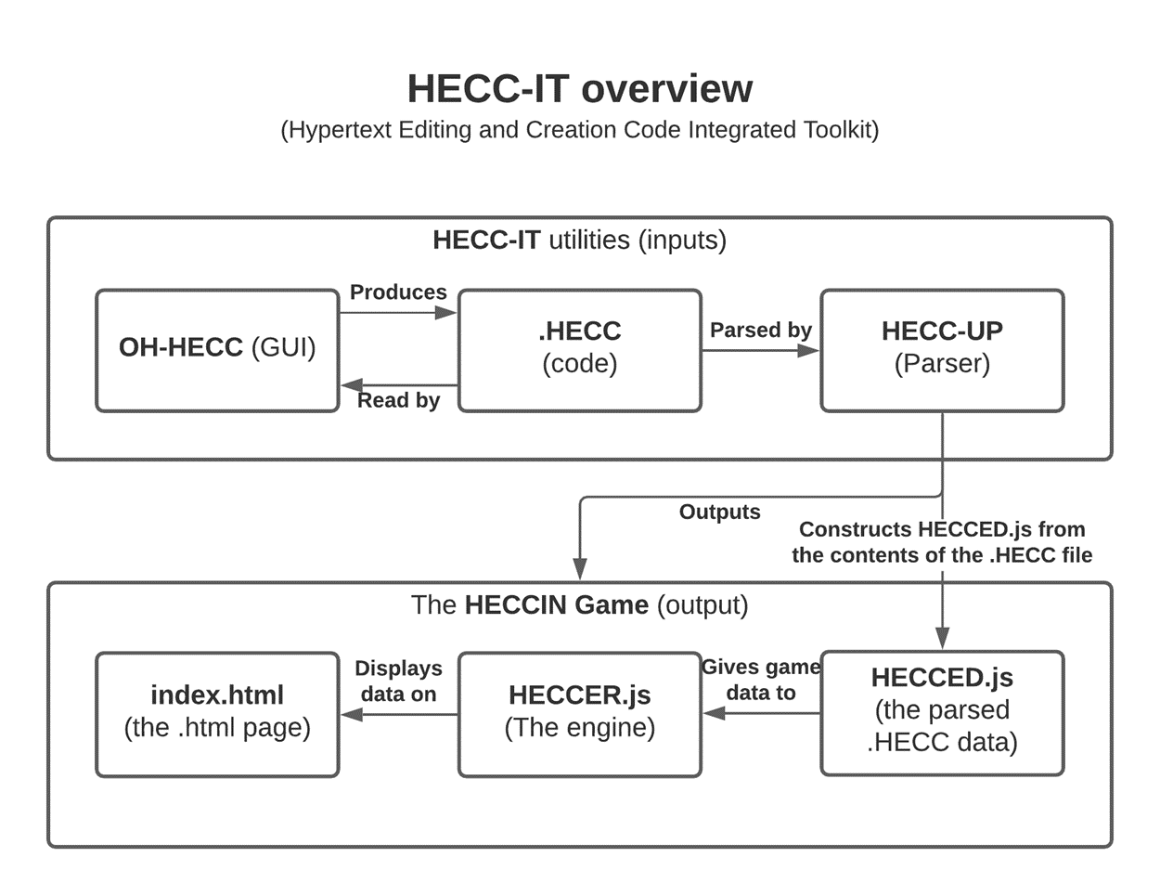

Slide 6
The .hecc language (Hypertext Editing and Creation Code)
Syntax is very similar to that of Twee and Squiffy
Familiarity for people who already use those
Defined in the HECC-SPECC
HECC Super Precise Explanation for Creating Code
Has metadata
Author, game title, comments, start passage, IFID
Can define passages
Passage names, position in OH-HECC, tags, comments, and content
Passages also hold links to other passages

Slide 7

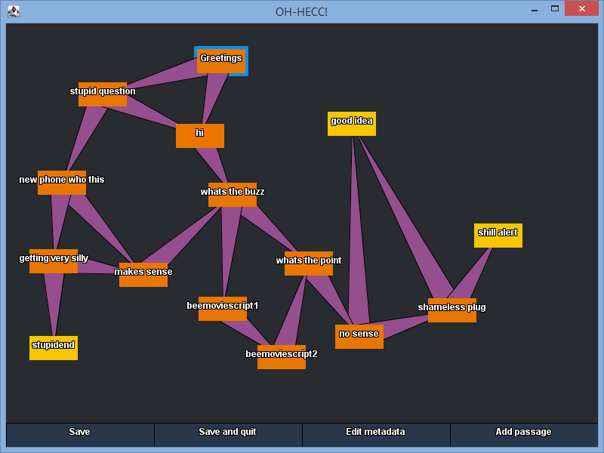
OH-HECC (Optional Help for HECC)
GUI for editing HECC
Can open existing .hecc files or make and edit a new .hecc file
Similar in functionality to Twine
Network of connected passages
Easy to add/edit/remove passages
Can edit metadata
Namesake was said several times whilst developing it.
But users hopefully won’t find themselves having to say it.

Slide 8
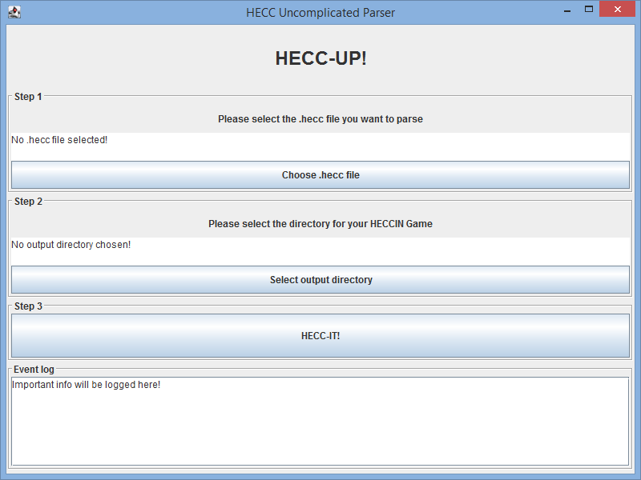
HECC-UP (HECC Uncomplicated Parser)
Give it a .hecc file and a location to save a HECCIN Game to
It’ll use that .hecc file to make a HECCIN Game.
Or it’ll complain if there’s a problem with your .hecc file
And it’ll tell you what caused the HECC-UP!

Slide 9

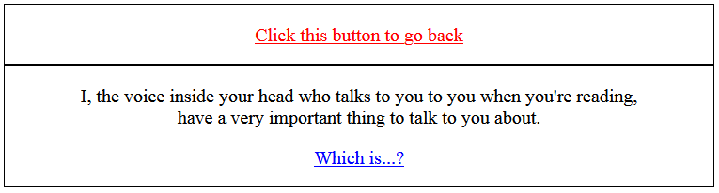
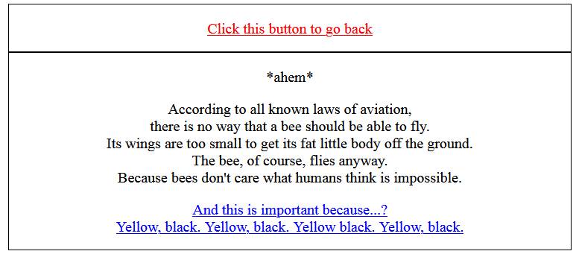
HECCIN Game (HECC-Infused Nice Game)
A hypertext game.

Slide 10
The HECCIN Game
Hecc-Infused Nice Game
Nice indicates that ‘oh nice you used HECC-IT to make this that’s cool’.

